Slide 1
Notes:
5 R01 DK0893293-03
5 R21 DK106603-02
(Merwin et al., 2014; 2015; 2018; Moskovich et al., 2019)

Slide 2
Disclosures:
Rhonda M. Merwin, PhD
Relevant Financial Relationships:
On Faculty at Duke University, School of Medicine
Research funded by National Institutes of Diabetes and Digestive and Kidney Diseases (NIDDK)
Receive royalties from Guilford publications for a book co-written on a topic similar to the subject of this presentation
Relevant Nonfinancial Relationships
Advisory Board for Diabetes Sisters

Slide 3
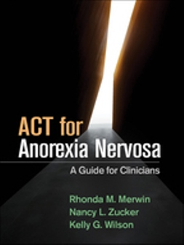
Available now

Slide 4
iACT to Reduce Maladaptive Eating and Weight Control in Type 1 Diabetes
Rhonda M. Merwin, PhD & Ashley A. Moskovich, PhD
Department of Psychiatry and Behavioral Sciences
Duke School of Medicine
ACBS World Conference 17, Dublin, Ireland
June 25-30, 2019

Slide 5
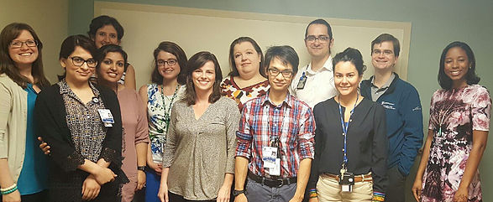
Division of Behavioral Medicine
and the
ACT IN CONTEXT RESEARCH LAB

Slide 6
Type 1 diabetes
Autoimmune disorder, destroys body’s ability to produce insulin
Survive by self-monitoring BG, administering insulin multiple times a day, precise management of diet and exercise
EDs are a severe threat to clinical management of T1D
Include typical ED bxs + insulin restriction

Slide 7
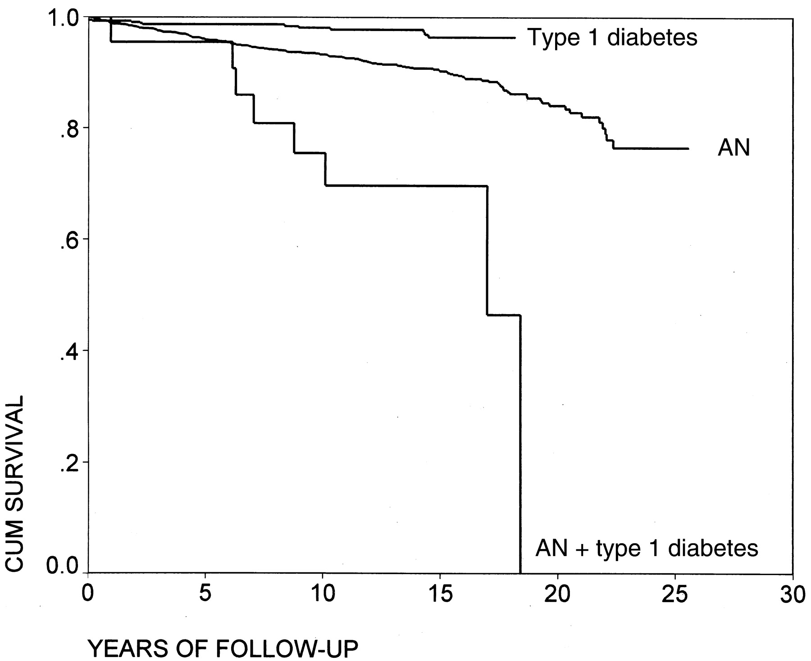
Mortality (Nielsen, 2002)

Slide 8
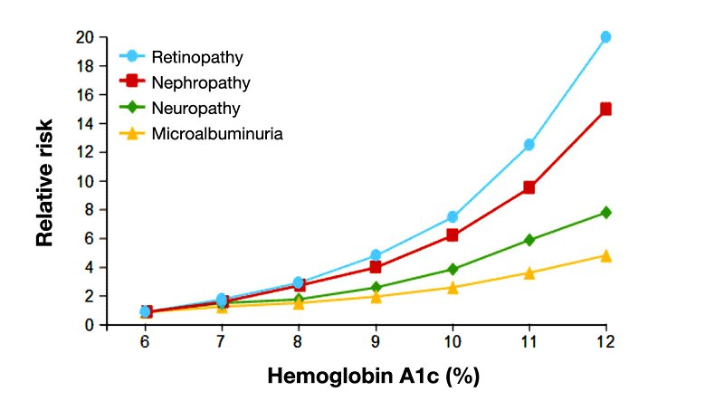
Morbidity (DCCT Trial)

Slide 9
Treatment options
There are no empirically-based treatments
Do not fare as well in conventional ED treatments
Body weight and shape concerns might improve, but T1D management behavior does not

Slide 11
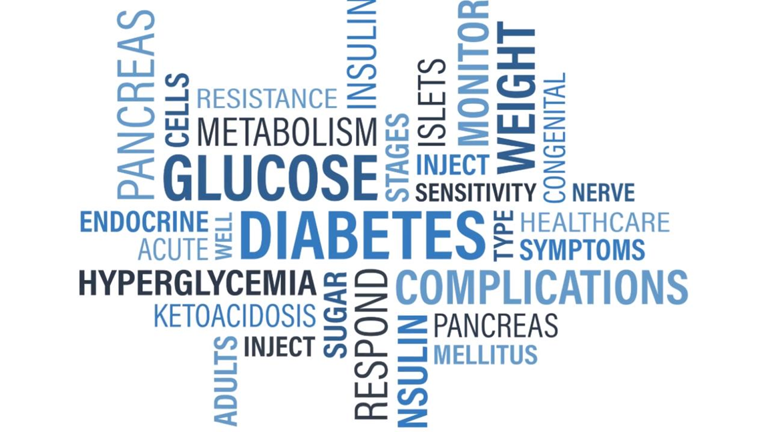
Context matters
In this case, the context of T1D
Maladaptive attempts to manage the physical and emotional demands of living with T1D

Slide 12
Living with T1D
Constant threat of immediately life-threatening circumstances
Knowledge of negative long-term outcomes no matter how hard you try
Demand to control BG that is not 100% in your control
Language of evaluation (good/bad, “correct”)
Feelings of failure when
You misjudge your hunger and eat more than you intended or when you didn’t intend to
Or when your BG does up more than you expected (or unexpectedly)
Fear, uncertainty, loss of control. Feelings of failure and being overwhelmed. Need to control self or situation.

Slide 13
Working model
Emotional distress
Generally and about T1D
Try to follow inordinately strict dietary rules
Feel deprived
Eat or overeat on highly palatable foods;
Omit insulin;
Avoid checking BG
Immediate distress decreases; weight loss.
BG remains high or erratic, perpetuating feelings of fear, failure etc. and BG-driven disruptions in mood

Slide 14
iOmit (now iACT): Reducing intentional insulin misuse in type 1 diabetes
(R21 DK106603, PI: Merwin)

Slide 15
iACT
Novel ACT protocol tailored to this population.
Combines individual sessions with a mobile app to facilitate skill acquisition and generalization and enhance life vitality.

Slide 16
Treatment themes
Differentiating pain (of living with T1D) from suffering (that comes with resistance to experience)
Taking a kinder, gentler approach to managing eating and T1D
Decreasing judgment, giving permission to eat
Connecting behavior (including T1D management) to deeply held personal values
Becoming a responsive, attuned “self-parent”
Open to internal signals (hunger,/satiety emotions) and the needs they convey
*Included behavioral strategies to stabilize eating (e.g., eating throughout the day, stimulus control, etc.)

Slide 17
Tailored mobile app
Practice ACT skills in the home environment
Cue adaptive responses
Shift the contingencies to support approaching T1D (even though it is aversive)
Improved management builds mastery and stabilizes mood

Slide 18
Tailored mobile app
Built on the platform of an existing app, Recovery Record
Core features (original set)
Logs
Coping skills (linked)
Goal setting
Affirmations
Clinician connect
Adapted for T1D, and ACT

Slide 19
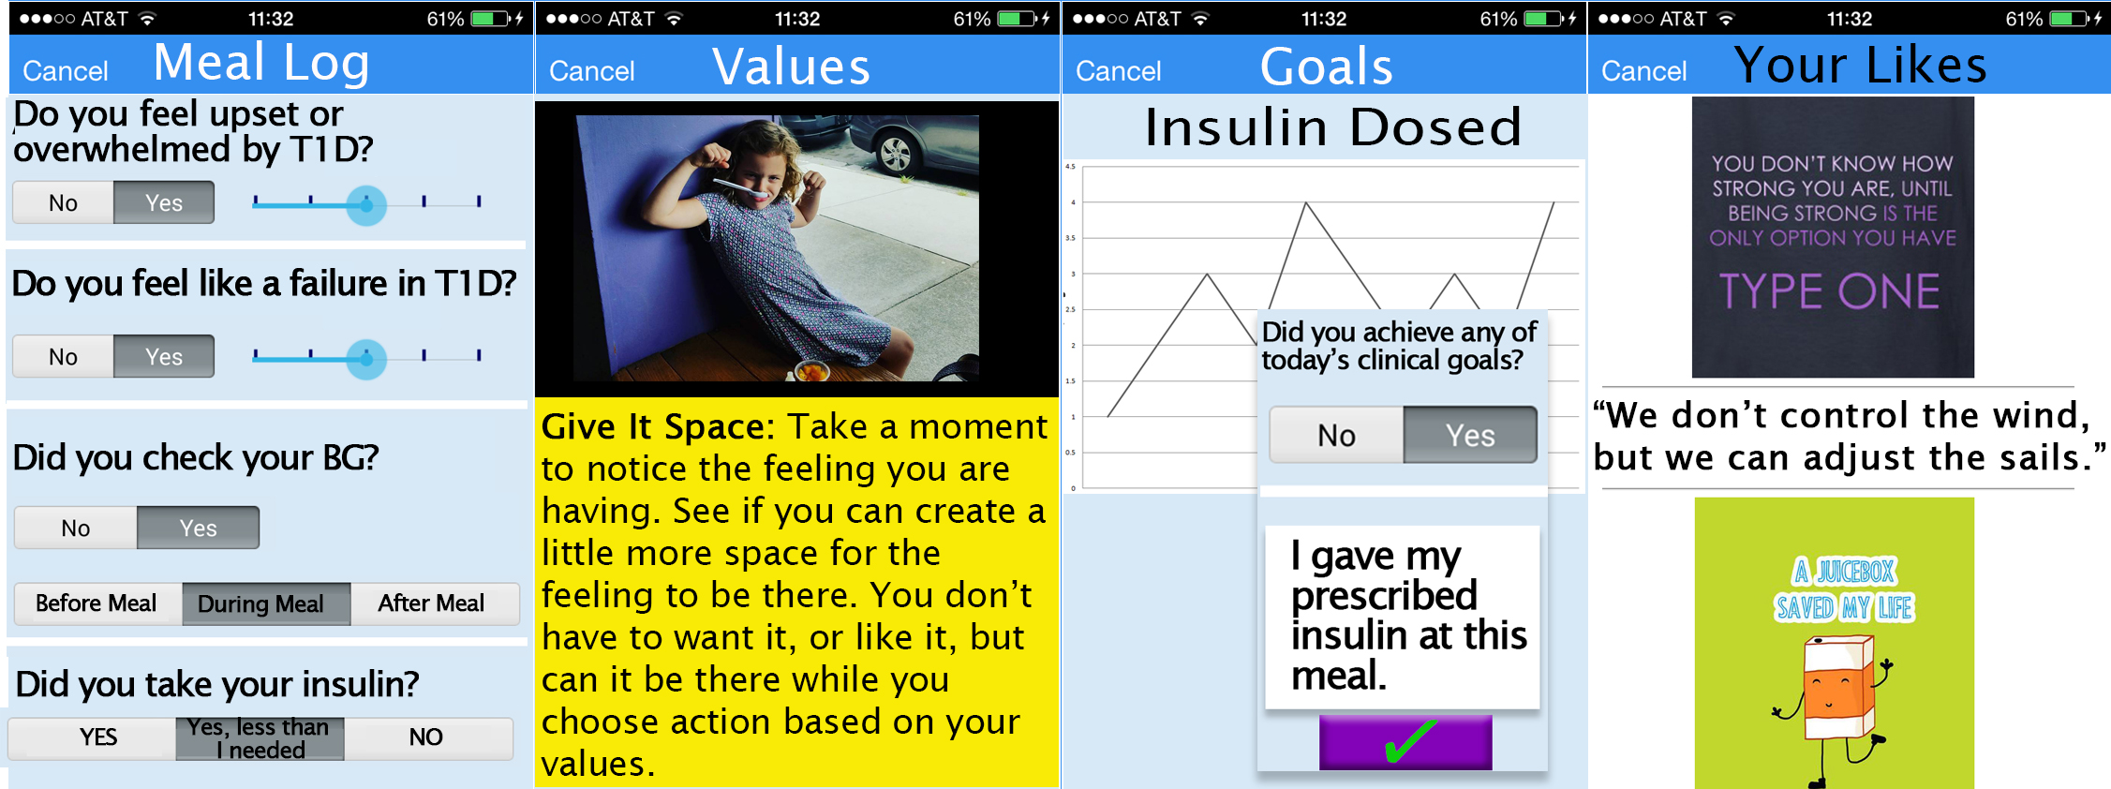
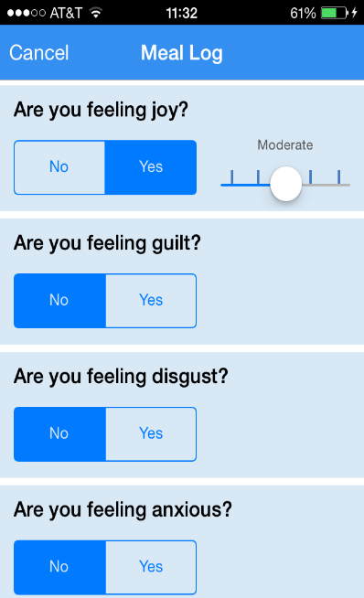
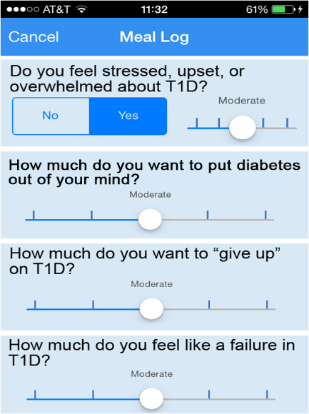
iACT modified app (sample screenshots)

Slide 20
Focus groups and interviews

Slide 21
Beta testing
T1D patients (n=8) with eating and weight concerns used the fully functioning app for 14 days
Accessed the app 47.56 times during the 14-day study period (or 3.75 times per day, on average)
No functionality errors/problems

Slide 22
Pilot of treatment
Eligibility Criteria
Adults 18 or older with T1D
Meet diagnostic criteria for an eating disorder
Poor glycemic control
Ability for independent T1D
management
5. Physician managing diabetes 6. Ability to use a smart phone
Ineligible
Psychosis or active substance abuse
Suicidality or self-harm
12 weekly sessions (3 additional sessions every other week)
BL, EOT, 3 and 6 months follow-up

Slide 23
Recruitment and retention
28 Recruited
Withdrew before beginning treatment (n=5)
Completed
(n=20)
Withdrawn
by PI
(n=1)
Withdrew before completing treatment
(n=2)
Completed EOT assessment
(n=20)
Completed
3 month
(n=16)
Completed
6 months
(n=15)

Slide 24
Participant Characteristics | M (SD)
Age (yrs.) | 34.8 (12.4)
Sex (% female) | 100
Race/Ethnicity Caucasian/White African American/Black More than one race | 78.6 14.3 7.1
Marital Status Never married Married Separated/divorced Unknown | 46.4 25.0 14.3 14.3
Highest Level of Education Some high school Some college/technical school Bachelor’s degree Graduate degree Unknown | 3.6 25.0 28.6 28.6 14.3

Slide 25
*Bulimia nervosa (n=17) includes 5 subthreshold cases, with frequency just under DSM criteria

Slide 26
Glycemic control
HbA_{1c} = % of red blood cells that are glycated, avg over 3 months
7% is the goal for adults with T1D

Slide 27
Glycemic control
HbA_{1c} of the sample ranged from 6.1-15.5 (M=9.93, SD=2.81)
n=4 had HbA1c’s below 7.5% but were in poor glycemic control based on other parameters (BG variability, e.g., vacillating between 40-400mg/dl).
HbA_{1c} may increase as ED bxs improve.

Slide 28
Measures
Baseline and EOT only:
Eating Disorder Examination (EDE)
All assessment points (BL, EOT, 3 and 6 months):
Diabetes Eating Problems Survey (DEPS)
Diabetes Self-Management Questionnaire (DSMQ)
Diabetes Distress Scale (DDS)
Acceptance and Action Diabetes Questionnaire (AADQ)
HbA_{1c}
Behavioral and app use data

Slide 29
RESULTS
*One subject removed prior to analyses due to late reveal of psychosis

Slide 30
Means (sd)

Slide 31
Change BL to EOT

Slide 32
BL to 3 MO

Slide 33
BL to 6 MO

Slide 34
HbA1c
A lot of variability in outcome
Changes ranged from -7.40-1.50
Mean change -1.14
Δ -.5 is considered clinically significant
Past studies have reported change -.18

Slide 35
HbA1c

Slide 36
*By individual participant, arrows denote participants with HbA1c ≥ 7.5 at baseline. Gap is a
participant without change in HbA1c with specific values unreadable > 15.5.

Slide 37
Conclusions
Promising intervention
Need to examine app use data (some behavioral and contextual data in there too) and individual trajectories of change
May apply to a broader population of T1D patients who are struggling to manage eating and weight

Slide 38
In gratitude of the clients who are teaching us how to be useful to them. - Namaste

